Slide 1

Hip-Hop in Context
By: Ashlyn Hanks, McKinley Johnson, and Alex McClellan

Slide 2
The Benefits and Detriments of Hip Hop

Slide 3
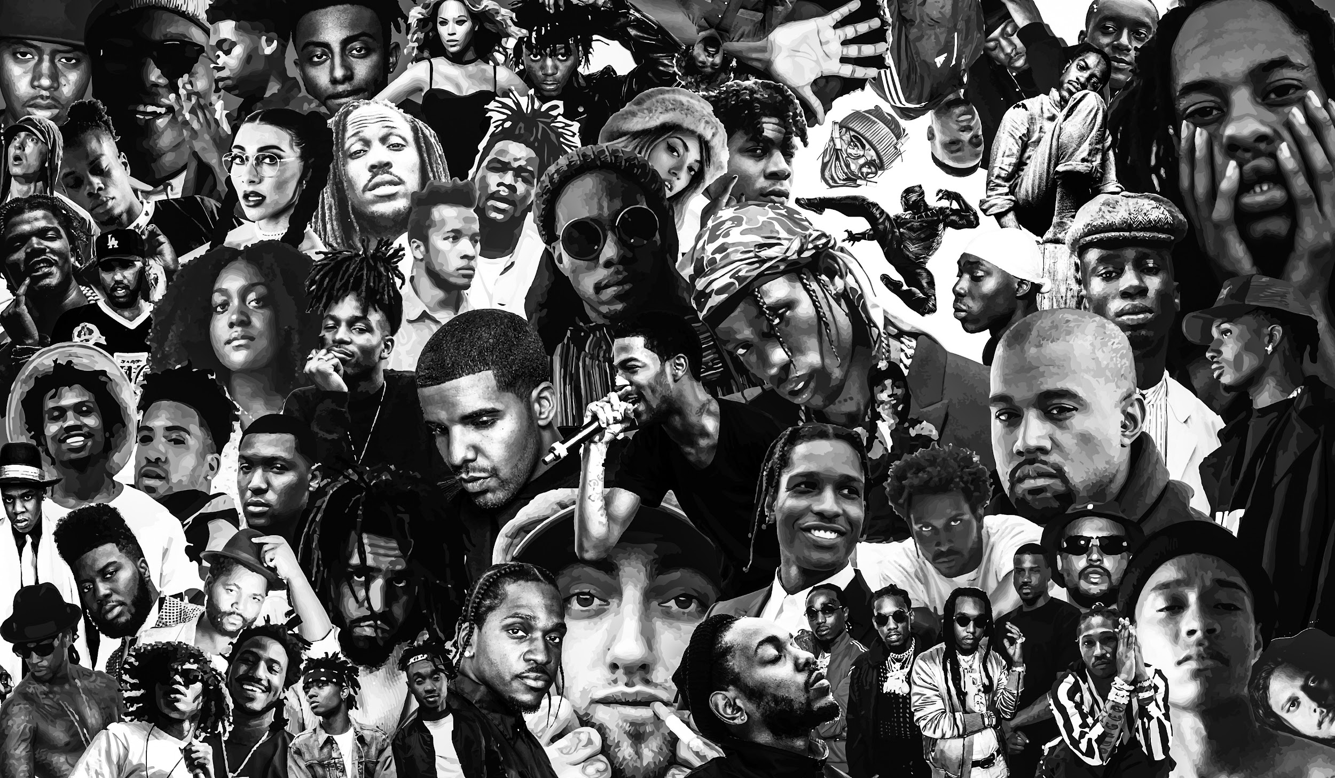
Does Hip-Hop bring anything good to society?
Absolutely!
Carries a message that can be heard by many
Brought about new ways of expression
Delivered social change and improvement
Encourages others to follow suit

Slide 4
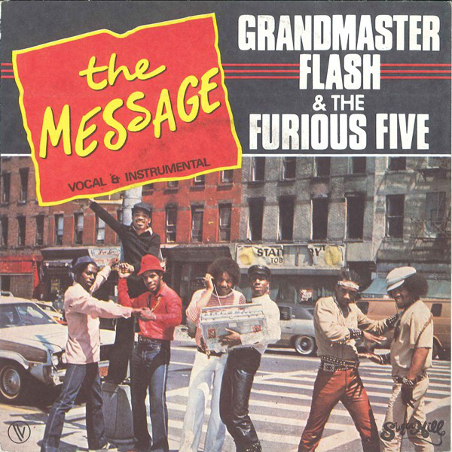

Messages and Social Change in Hip-Hop
Messages
Artists can craft a meaningful yet pleasing narrative
They realized the potential for this during the beginning of Hip-Hop
Hip-Hop messages can become widespread due to the musical nature
The Message
NY lifestyle and struggle for the Five
Social Change
Nipsey Hussle
Started local businesses for his community
Inspired other rappers and people with influence to follow

Slide 5
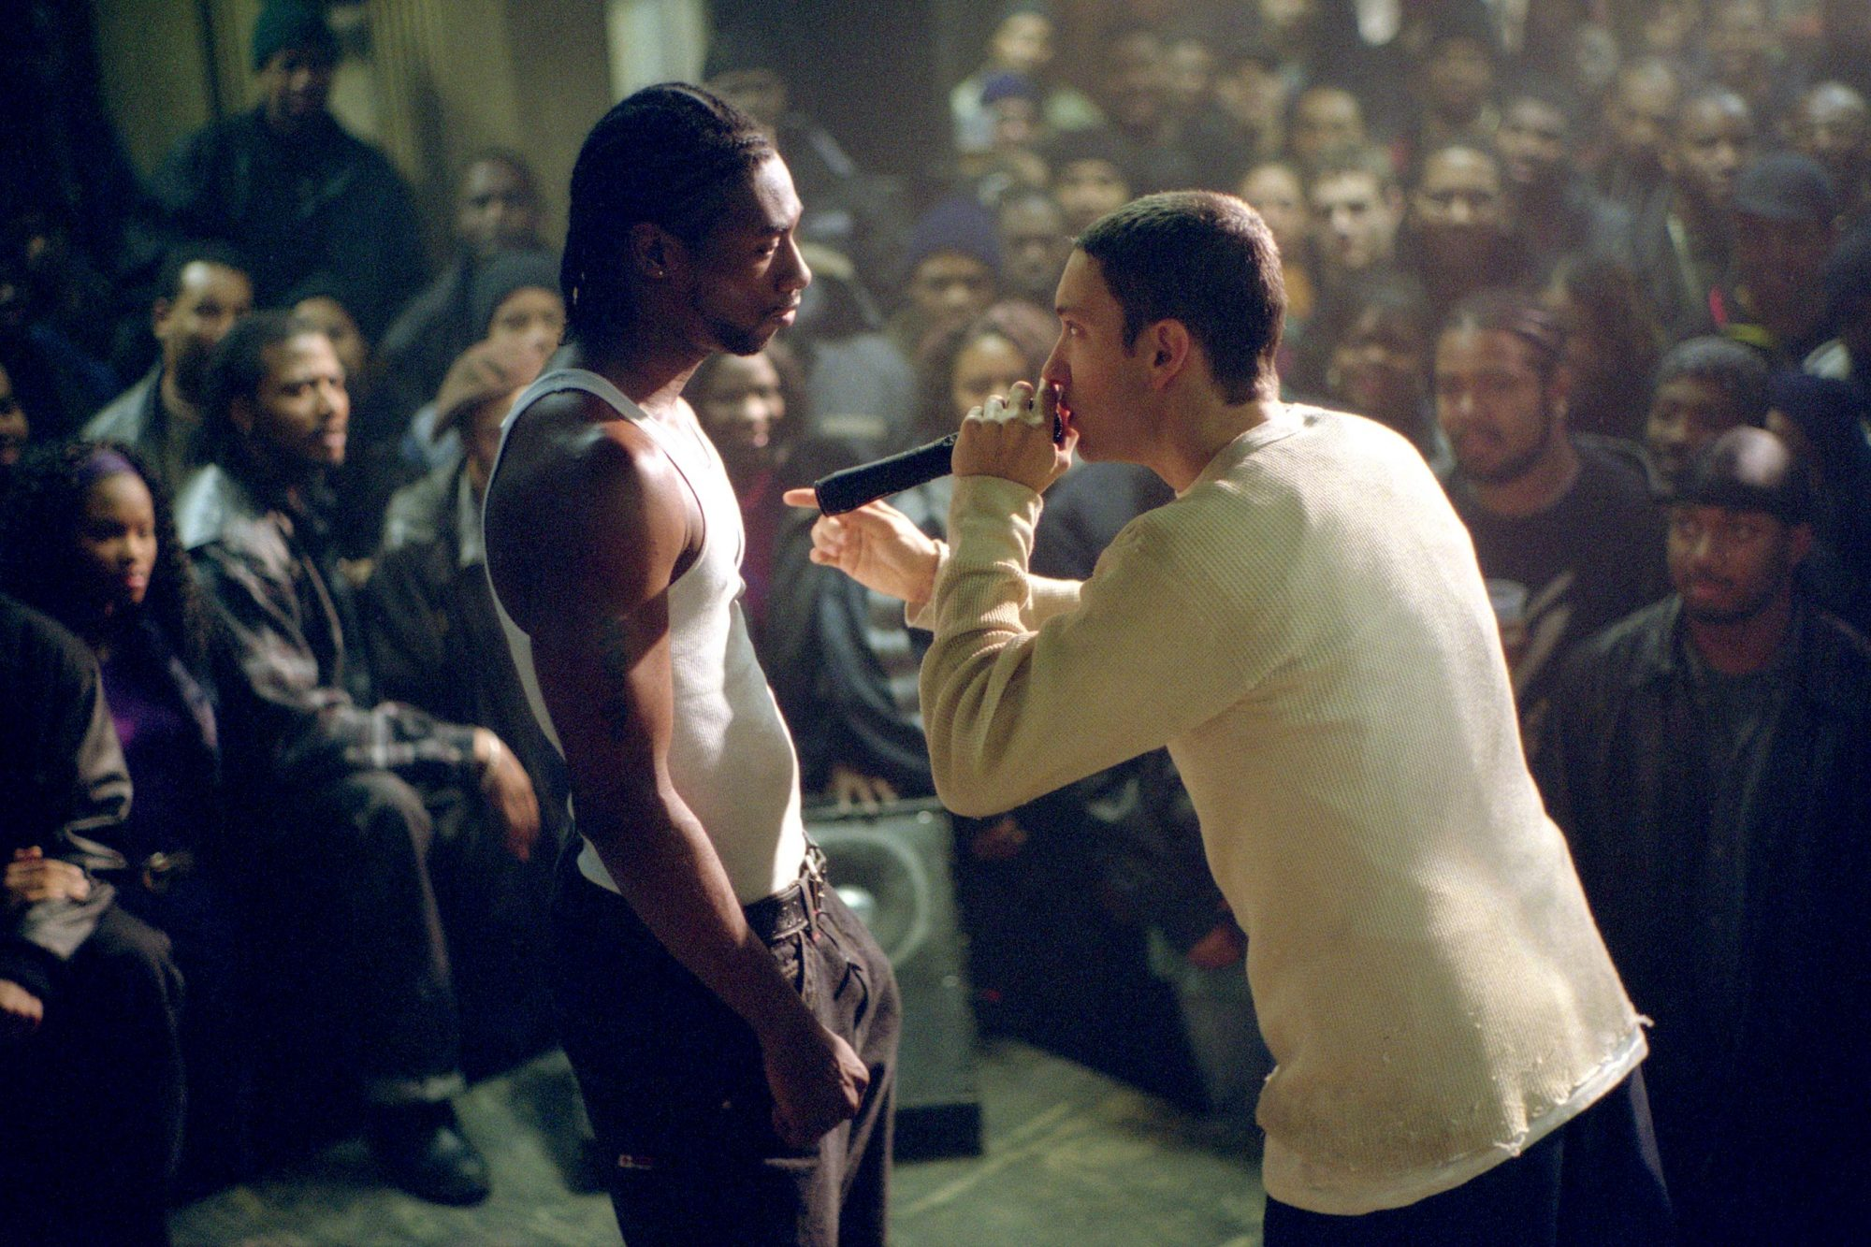
Does Hip-Hop bring anything bad to society?
Encourages others to continue to pursue harm
Drugs
Violence
Crime
Brings out a desire in listeners to follow that rapper’s harm
Fosters petty fights (beefs) between artists and people
Inspires rappers to one-up each other
Doesn’t do any good for anyone

Slide 6
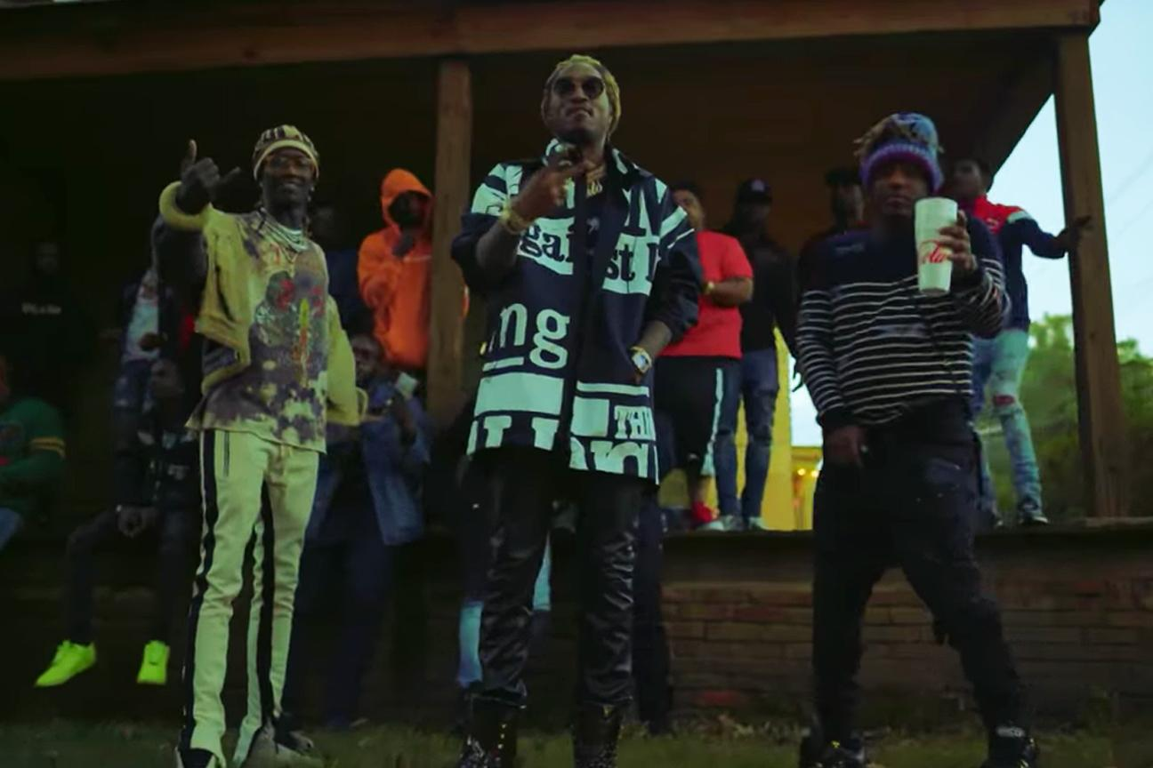
Concerns about the Future of Hip-Hop
Continued encouragement of bad habits and downfalls
More fans can be drawn into drugs or violence
Example: Juice WRLD and Future
People dying over the genre through gang violence
Example: OG ManMan
Keeps the cycle going
More rap beefs starting for clout and fame
Seeing the fans come to artists over arguments
Thinks it will help further their career
In the end, doesn’t do much at all

Slide 7
Hip Hop in Literature Education

Slide 8
The Need
Current disconnect between students and education
Especially literature education
Unmet needs of growing student diversity
Inaccessibility of relevance within canonical literature
Hip Hop can bridge gap and raise student interest in their own education and field of literature

Slide 9
Diversity
Student diversity on rise while diversity of teachers shrinks
Hip Hop has strong influence on culture
Regardless of race, socioeconomics, etc.
Particularly for young people
Teachers asked to teach students of unfamiliar background and culture
Leads to lowered interest in education, especially in minority students
Canonical literature is lacking in diversity
Hip Hop can address these problems
Also beneficial to non minority students

Slide 10
Inaccessibility of Relevance in Canonical Lit
Most literature studies focus on old pieces with inaccessible language and ideas
Hip Hop would provide some balance to age of pieces studied
Introduce students to skills necessary to unlock relevance in canon
Hip Hop influential to culture today
Its relevance would make it a bridge between student interest and education

Slide 11
When and How to Incorporate
During discussions of literacy
To teach for and validate student identities, experiences, and opinions
Use Hip Hop as its own form of literature, not as a bridge to canonical literature

Slide 12
Hip Hop and Mental Health

Slide 13
Importance
Suicide rates increased in 2020 alone
African American youth are at the most high risk
De-stigmatize
Directly help through music therapy

Slide 14
De-stigmatization
Mac Miller
Kendrick Lamar
Juice Wrld

Slide 15
Community Impact
Sense of empowerment, street smarts, resilience, self-healing
Problem solving, self-esteem, interpersonal relations
Being used as a form of music therapy

Slide 16
Discussion

